Slide 1
Operating Systems

Slide 2
Course synopsis
Instructor: Prof. Youjip Won(ywon@kaist.ac.kr, #220-N26)
TA’s
Dohyun Kim (ehgus421210@kaist.ac.kr)
Minsu Jang (nobleminsu@gmail.com)
SeungWon Yoo (swyoo98@kaist.ac.kr)
Class
Monday: 13:00 – 14:15, Wednesday: 13:00 – 14:15
Office hour
Monday: 15:00 – 16:00 (for offline class)
Anytime via email or zoom request (for online class)
two exams(midterm and final), Four projects in Pintos
prerequisite: C/C++, Data Structures
grading: homework(70%), midterm(15%), final(15%)

Slide 3
Resources
Primary Textbook
“Operating Systems: Three Easy Pieces v1.0”, Remzi Arpaci-Duseau and Andrea C. Arpaci-Dusseau (http://ostep.org)
Korean version: “운영체제: 아주 쉬운 세가지 이야기”, 역자: 원유집외 2명 (홍릉과학출판사)
Home page:
http://oslab.kaist.ac.kr
Youtube link for EE415
https://www.youtube.com/channel/UCg9wr-9UW3XrEddmZ73LIww
Q&A, discussion:
https://piazza.com/class/kywaer13kxsbf?cid=1

Slide 4
Resources
Slide sets for lecture(OSTEP books)
https://oslab.kaist.ac.kr/OSTEPSlides/
Slide sets for Pintos Projects:
https://oslab.kaist.ac.kr/pintosslides/
Slide sets for gdb, ctags and cscope (including video recording):
https://oslab.kaist.ac.kr/pintosslides/
Supplements:
Beginning Linux Programming 4th Ed., Neil Matthew and Richard Stones, July, 2008
Linux Kernel Development, 3rd Ed., Robert Love

Slide 5
tools
qemu
gdb
shell
ctags/cscope, etags
useful commands: nm, dtruss,

Slide 6
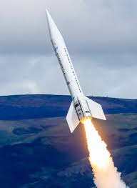
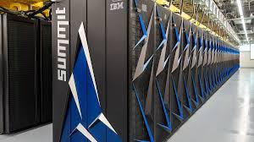
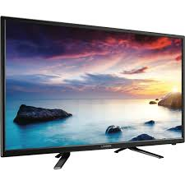
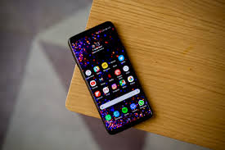
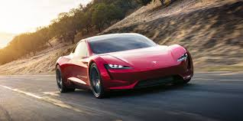
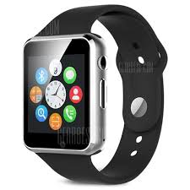
computing device

Slide 7
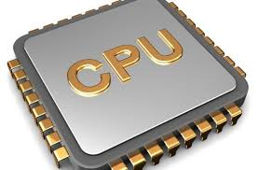
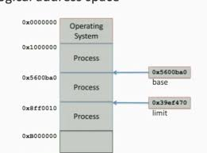
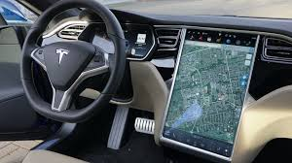
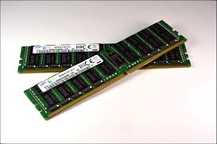
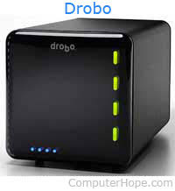
in essence from hardware

Slide 8
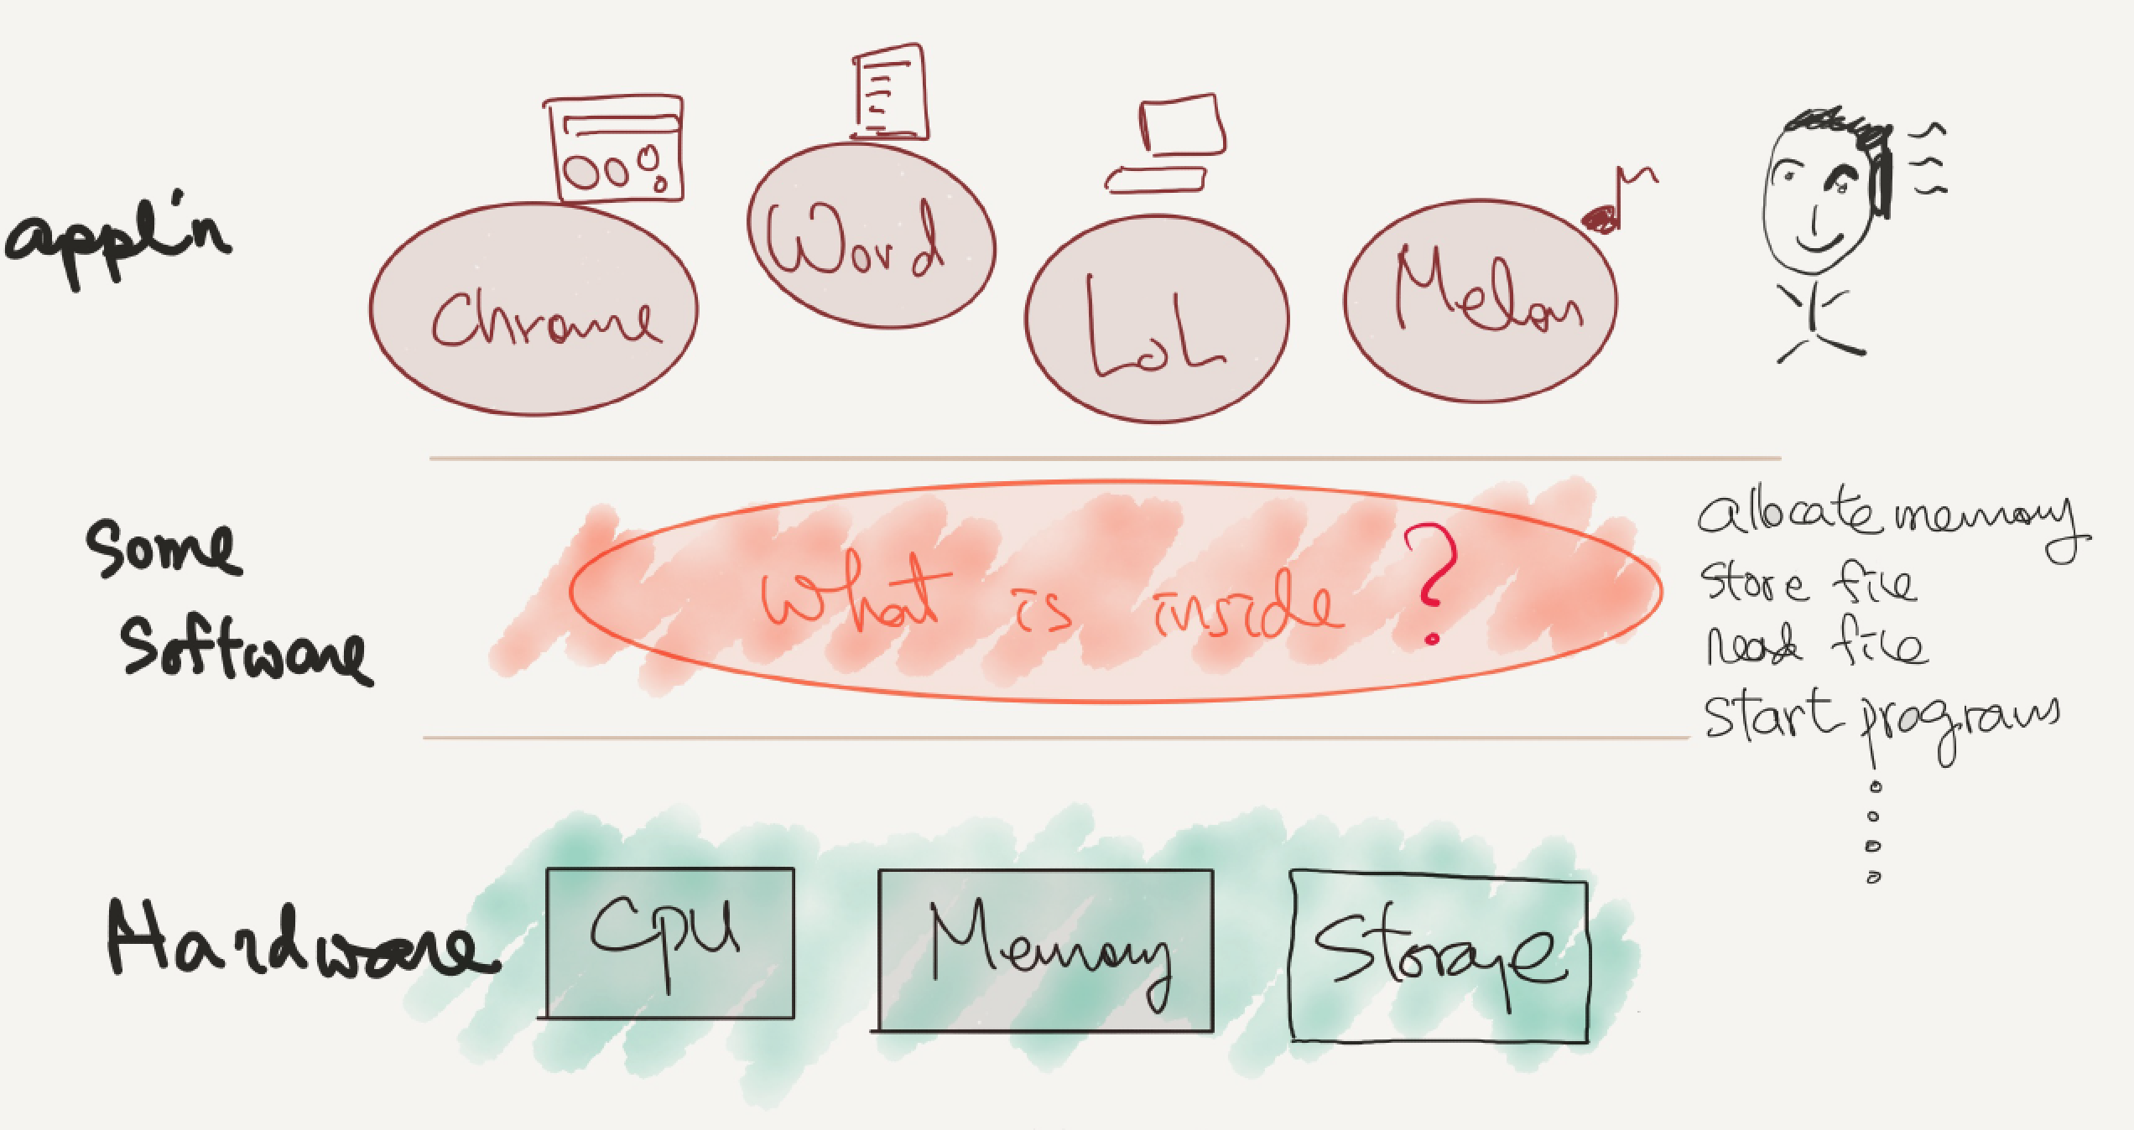
in essence from software

Slide 9
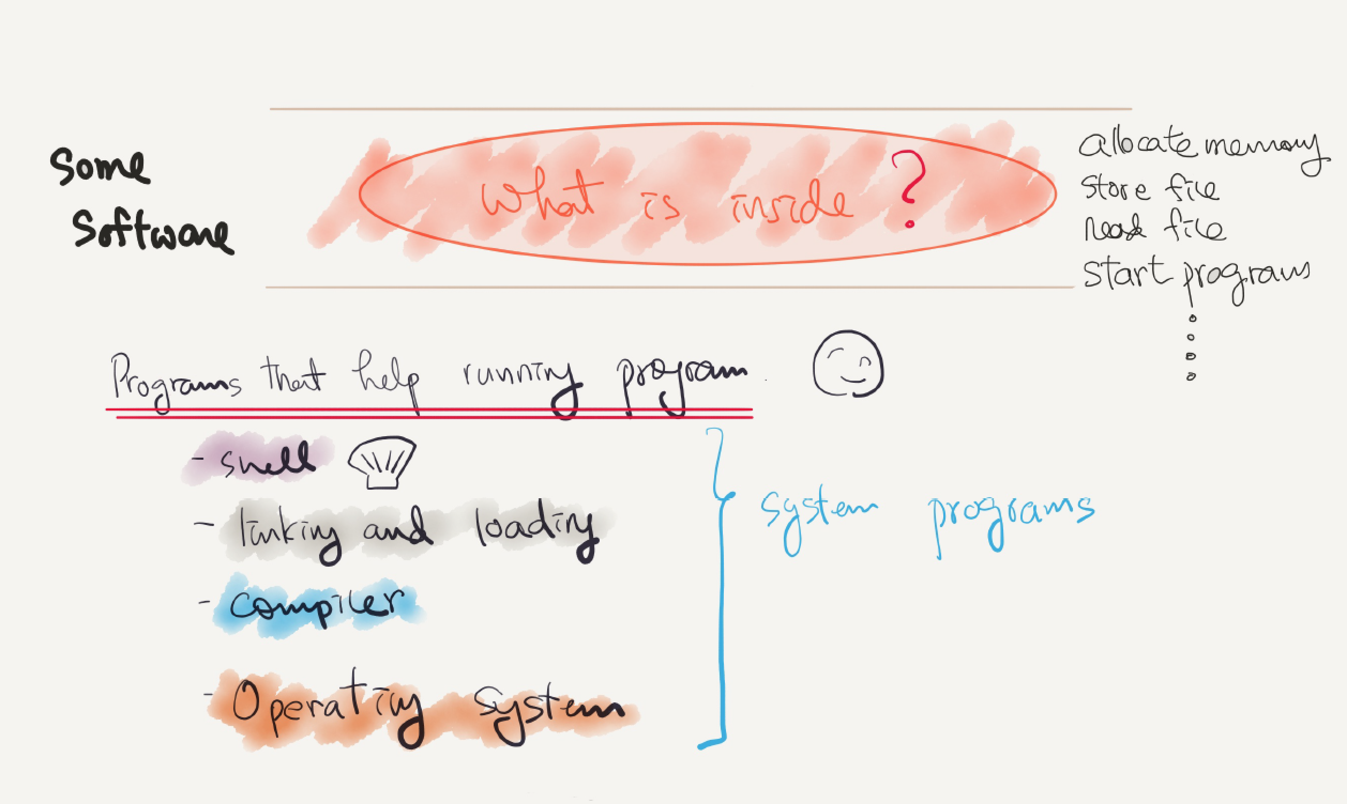
system program

Slide 10
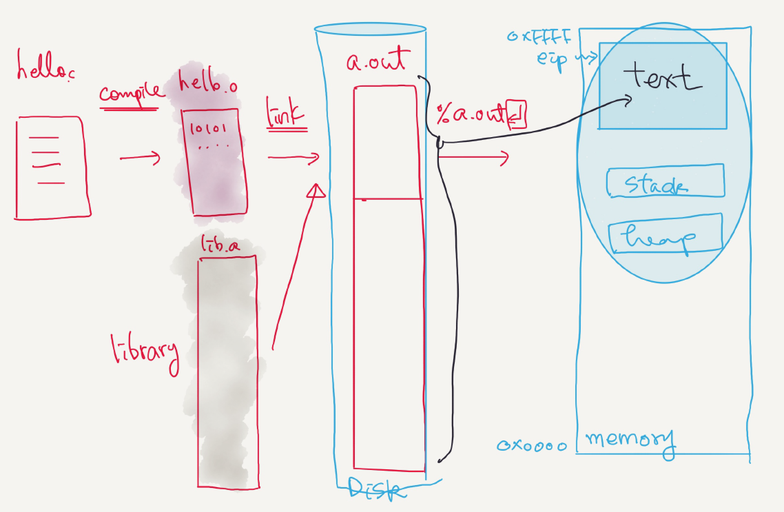
Life of a program

Slide 11
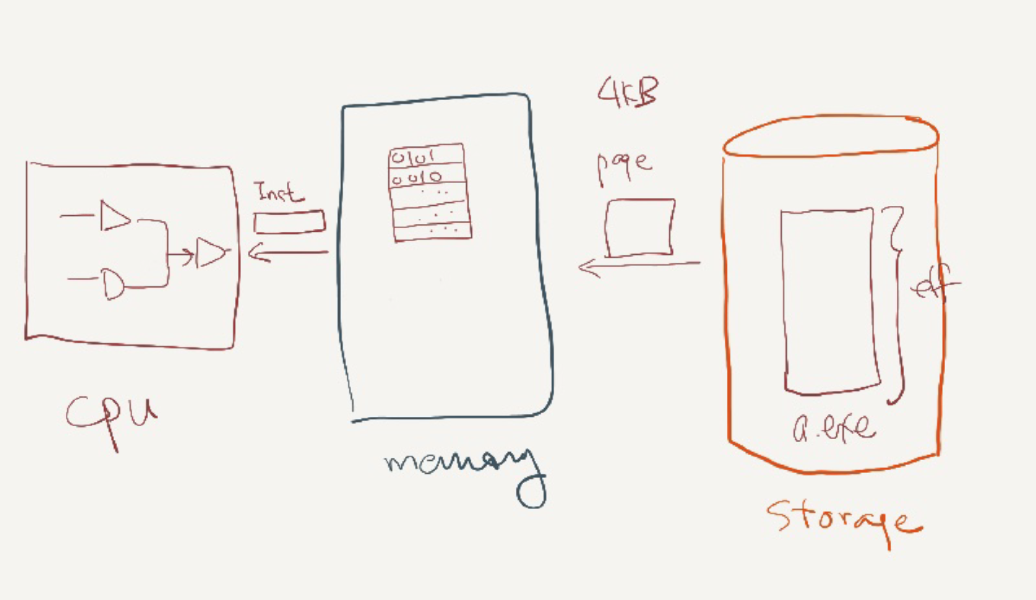
Execution of a program

Slide 12
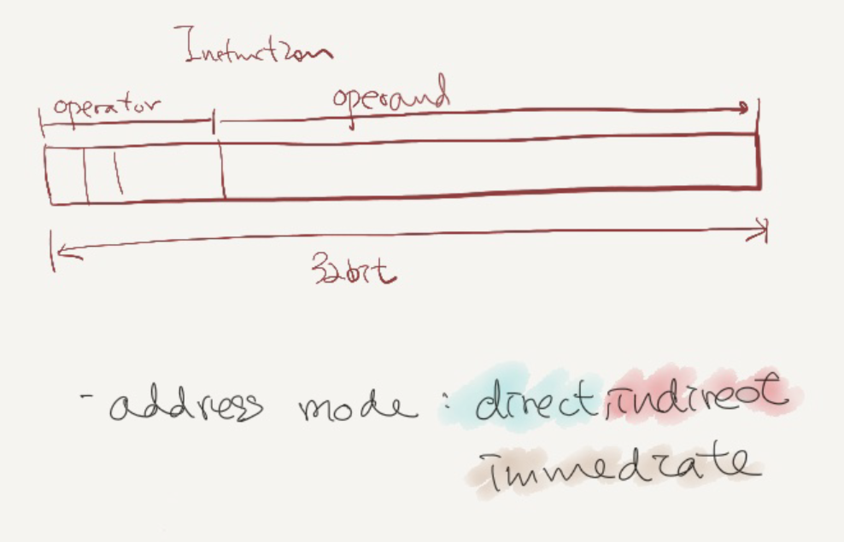
cpu

Slide 13
library

Slide 14
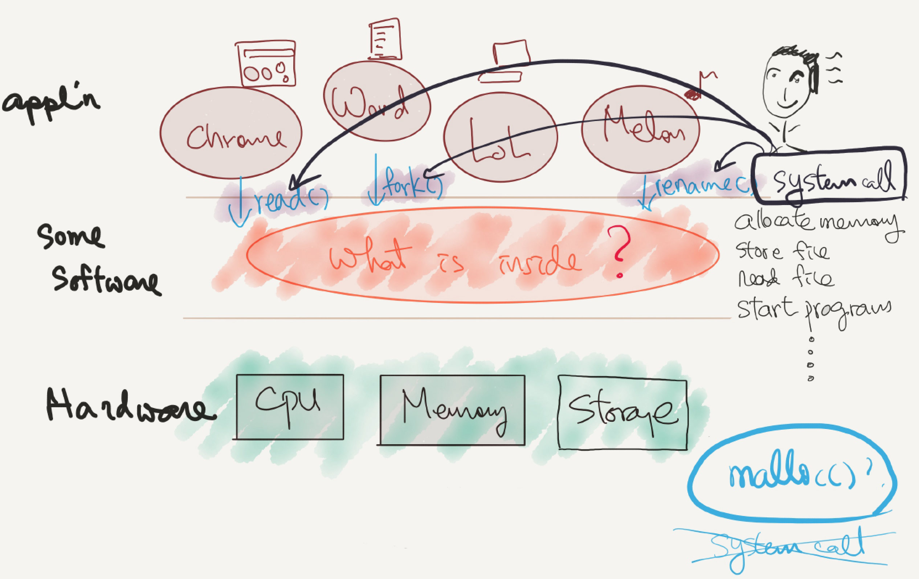
system calls

Slide 15
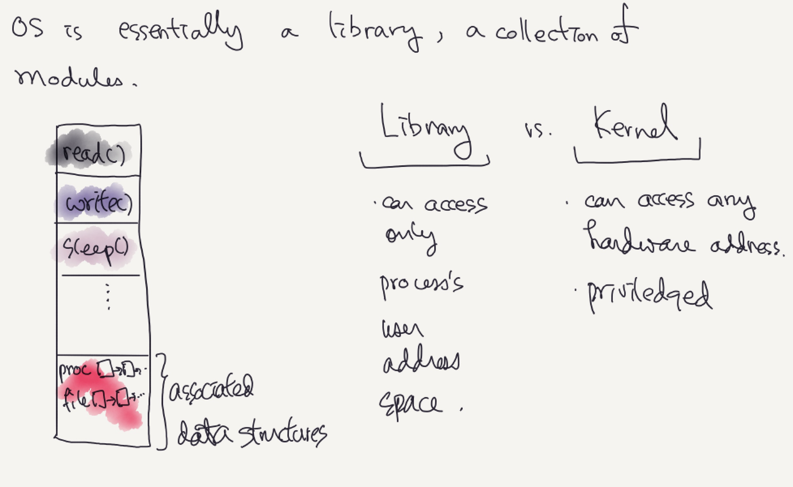
function call vs. system call

