Slide 1
Operating Systems

Slide 2
43. Log-structured File Systems

Slide 3
Overview
The Motivation …
Memory sizes were growing.
Large gap between random IO and sequential IO performance.
Existing File System perform poorly on common workloads.
File System were not RAID-aware. There exists small write problem.
Log-Structured Filesystem(LFS)
Treat the filesystem partition as a log.
Append only.
Keep track of the most recent location of the file block.

Slide 4
Writing to Disk Sequentially: Basic Idea
Update a file: data write + inode update
data update
metadata needs to be updated too. (Ex. inode)
 | D
A0
blk[0]:A0
 | D | I
A0

Slide 5
Write Efficiently: Segment
Write buffering.
LFS keeps track of updates in memory; → If sufficient amount of updates are accumulated in memory, write them to the disk at once.
Segment: a set of sequential writes that are written to the disk with a single unit.
blk[0]:A0
blk[0]:A1
blk[0]:A2
blk[0]:A3
 | D[j,0] | D[j,1] | D[j,2] | D[j,3] |  | D[k,0]
blk[0]:A5
A0
A1
A2
A3
inode[j]
A5
inode[k]

Slide 6
Right segment size
Time to write D Mbyte
$T_{write}=T_{position}+\frac{D}{R_{peak} }$
Effective write bandwidth
$R_{effecitve}=\frac{D}{T_{write} }=\frac{D}{T_{position+ }\frac{D}{R_{peak} }}$
We like to make the effective write bandwidth close to peak bandwidth with some fraction F ( 0<F<1)
$$R_{effecitve}=\frac{D}{T_{position+ }\frac{D}{R_{peak} }}=F x R_{peak}$$

Slide 7
Right segment size
Then, D can be computed as follows.
$$D=F x{ R}_{peak} x{ (T}_{position}+\frac{D}{R_{peak} })$$
$$D=\left(F x{ R}_{peak} x { T}_{position}\right)+\left(F x{ R}_{peak} x \frac{D}{R_{peak} }\right)$$
$D=\frac{F}{1−F}$ $x{ R}_{peak} x { T}_{position}$
Example: Positioning time 10 msec, peak transfer rate 100MByte/sec, we like to achieve 90% of the peak rate
D = 0.9*10*100 Mbyte/sec * 0.01 secs = 9 Mbyte
What is D if F = 0.95?

Slide 8
Finding an Inode: Inode Map, the level of indirection
The position of the inodes keep changing.
The level of indirection: inode map
[inode no, Ldisk location]
Places the chunk of updated inode map next to the updated inode.
Where to find the inode map?
blk[0]:A0
map[k]:A1
 | D | I[k] | imap
A0
A1

Slide 9
Finding an inode map: The Checkpoint Region
How to find the inode map spread across the disk?
The LFS File system must have fixed location on disk to begin a file lookup.
Checkpoint Region
fixed location in the LFS partition.
Contain the pointers to the latest inode map.
blk[0]:A0
map[k]:A1
CR |  | D | I[k] | imap
imap
[k..k+N]:
A2
0
A0
A1
A2

Slide 10
Reading a file from the disk
Reading a file block
Read a checkpoint region
Read inode map
Read inode
Read data block
What about sequential read?
It may become random read.
LFS is optimized for the write operation.

Slide 11
What About Directories?
Directory: a set of <inode, filename>
How does LFS store directory data?
Creating a file: foo
Update the directory inode. (inode #: dir)
Update the directory entry. (foo, k)
Update inode for the created file. (inode #: k)
Update the data block for the created file.
blk[0]:A0
(foo,k)
blk[0]:A2
map[k]:A1
map[dir]:A3
 | D[k] | I[k] | D[dir] | I[dir] | imap
A0
A1
A2
A3

Slide 12
Garbage Collection
LFS never overwrites. → A block becomes obsolete as it is updated.
Garbage: obsolete file block
An example of garbage
Overwrite the data block:
Append a block to that original file k:
blk[0]:A0
blk[0]:A4
 | D0 | I[k] |  | D0 | I[k]
A0
(both garbage)
A4
blk[0]:A0
 | D0 | I[k] |  | D1
I[k]
blk[0]:A0
blk[1]:A4
A0
(garbage)
A4

Slide 13
Garbage Collection (segment cleaning)
What to do with the older versions of the block
Versioning filesystem: keep the old blocks and allow the users to restore to the older version of the filesystem status.
LFS: periodically clean the older versions of the file data, inodes and other structures.
Unit of garbage collection: Segment
Reads a number of old segments, M segments.
Identify the valid blocks.
Write them to a number of new segments (in memory), N segments.
Write N segments to the disk.
Then, N < M.

Slide 14
Garbage collection
Update existing data
Find a free block,
and save the new data
This scenario may continue until there
are not enough free blocks
Invalid
Invalid
Invalid
Invalid
Invalid
Invalid
Invalid
Invalid
New Data
Invalid
Invalid
Invalid
segment (A)
segment (A)
segment (A)
segment (B)
segment (C)
Invalid
Invalid
Invalid
Invalid
Invalid
Invalid
Invalid
Invalid
Invalid
Invalid
segment (A)
segment (B)
segment (C)
segment (A)
segment (B)
segment (C)

Slide 15
Reverse Mapping Information
File map: [ino, offset] → block
Reverse map: block → [ino, offset]
In garbage collection, we need to migrate the valid blocks.
To identify the valid blocks,
For each segment, LFS stores the reverse map for each block in the segment.
Get [ino, offset] for block D.
Look for [ino, offset] from the file map, D’.
If D == D’, D is valid.
blk[0]:A0
map[k]:A1
A0: (K,0) SS | D | I[k] | imap
A0
A1

Slide 16
Issues in garbage collection
When to clean
Periodically
When a system is idle
When the disk is full
Which block to consolidate?
Hot segment: the blocks are updated periodically
Cold segment: the blocks are not updated.
Hot segment: clean later.
Cold segment: clean sooner.

Slide 17
Crash recovery
What if the crash happens when the LFS is in the middle of writing the segment to the disk?
LFS maintains a set of segments as a linked list in memory
LFS organizes the filesystem partition as a log (a linked list of the segments).
Two checkpoint regions: one at the beginning and the one at the end.

Slide 18
Crash recovery
Consistent Update on CR
Write timestamp at the beginning of CR.
Write CR body.
Write time stamp at the end of the CR.
When crash occurs, chooses the most recent CR with valid consistent time stamps.
Crash recovery
Read the CR and rebuild imap.
Perform roll-forward recovery.
Start from the first segment in CR.
Scan the valid segment following the “next segment” pointer and update the imap.

Slide 19
Summary
LFS: write optimized filesystem.
Gather all updates into an in-memory segment.
Write them out together sequentially.
LFS-style is excellent for performance on many different devices.
Hard drives, parity-based RAIDs, even Flash-based SSDs.

Slide 20
What we have learned at EE415 @ Spring 2022
Operating System: A software that deals with hardware

Slide 21
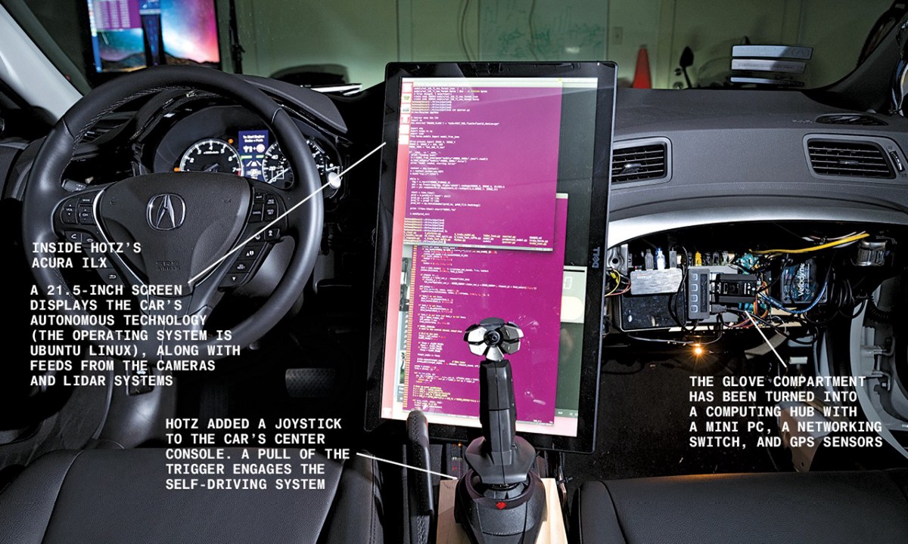
What we have learned
What does it drive?

Slide 22
Final Exam
Monday Jun 13, 2022
13:00 – 16:00
Room N1-110, N1-112
Format
Open everything
Coding
Bring your notebook.
If you like to take exam online, send an inquiry to TA.

Slide 23
Three things to remember…
Read a lot.
Save time.
Do exercise.

Slide 24
Have a nice summer!

