Slide 1
Operating Systems

Slide 2
41. Locality and The Fast File System

Slide 3
Overview
The First UNIX File system:
Simple and supports the basic abstractions.: (file descriptor and offset)
Easy to use file system.
S | Inodes | Data
Data structures
However, Poor Performance !

Slide 4
Problem of Unix FileSystem (UFS)
Unix file system treated the disk as a random-access memory.
Example of random-access blocks with Four files.
Data blocks for each file can accessed by going back and forth the disk, because they are are contiguous.
File b and d is deleted.
File E is created with free blocks. (spread across the block)
A1 | A2 | B1 | B2 | C1 | C2 | D1 | D2
A1 | A2 |  |  | C1 | C2
A1 | A2 | E1 | E2 | C1 | C2 | E3 | E4

Slide 5
FFS: Disk Awareness is the solution
FFS is Fast File system designed by a group at Berkeley.
The design of FFS is that file system structures and allocation polices to be “disk aware” and improve performance.
Keep same API with file system. (open(), read(), write(), etc)
Changing the internal implementation.

Slide 6
Cylinder Group
FFS divides the disk into a bunch of groups. (Cylinder Group)
block group. In Linux
These groups are used to improve seek performance.
By placing two files within the same group.
Accessing one after the other will not be long seeks across the disk.
FFS needs to allocate the files and directories within each of these groups.
S | ib | db | Inodes | Data
Data structure for each cylinder group.
A copy of the super block
inode bitmap and data bitmap
inodes and data block

Slide 7
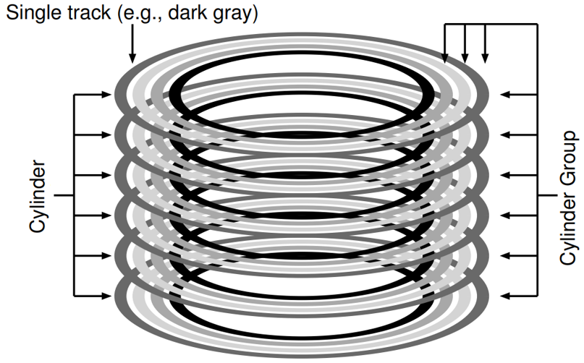
Cylinder Group (Cont.)
Cylinder: Tracks at same distance from center of drive across different surfaces.
All tracks with same color
Cylinder Group: Set of N consecutive cylinders
if N=3, first group does not include black track

Slide 8
How To Allocate Files and Directories?
Policy is “keep related stuff together”
The placement of directories
Find the cylinder group with a low number of allocated directories and a high number of free inodes.
Put the directory data and inode in that group.
The placement of files.
Allocate data blocks of a file in the same group as its inode
It places all files in the same group as their directory

Slide 9
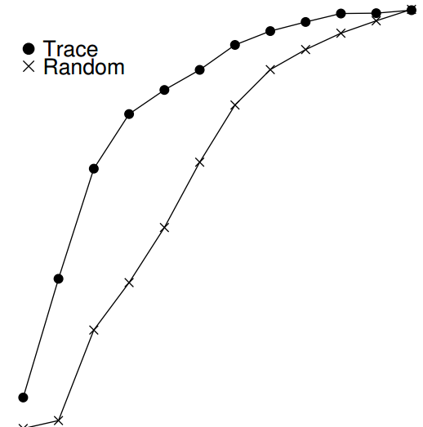
FFS Locality for SEER Traces.
SEER traces is analysis about how “far away” file accesses were from one another in the directory tree.
Path difference: how far up the directory tree you have to travel to find the common ancestor of two files
100%
80%
60%
Cumulative Frequency
40%
Trace
20%
x
Random
0%
0
2
4
6
8
10
Path Difference

Slide 10
The Large-File Exception
FFS without the large file exception handling.
FFS with the large file exception handling.
Spread blocks of a file across the disk.
Consider the time transferring big data from disk and block seek time.
G: block group
G0 | G1 | G2 | G3 | G4 | G5 | G6 | G7 | G8 | G9 | G10
0 1 2 3 4 5 6 7 9
G0 | G1 | G2 | G3 | G4 | G5 | G6 | G7 | G8 | G9 | G10
8 9 |  | 0 1 |  | 2 3 |  | 4 5 |  | 6 7

Slide 11
A few other things about FFS
Internal fragmentation
Sub-blocks
Ex) Create a file with 1 KB : use two sub-blocks, not an entire 4-KB blocks
Parameterization
Track buffer
Long file names
Enabling more expressive names in the file system
Symbolic link

Slide 12
Summary
The introduction of fast file system (FFS)
It finds that the problem of file management is one of the most. important issue within an operating system.
It makes file system fast, considering characteristic of disk.
Many file systems take cues from FFS.
ex) ext4, ext3, ext4

