Slide 1
Operating Systems

Slide 2
39. File and Directories

Slide 3
Persistent Storage
Keep a data intact even if there is a power loss.
Hard disk drive
Solid-state storage device
Two key abstractions in the virtualization of storage
File
Directory

Slide 4
File
A linear array of bytes
Each file has low-level name as inode number
The user is not aware of this name.
Filesystem has a responsibility to store data persistently on disk.

Slide 5
Directory
Directory is like a file, also has a low-level name.
It contains a list of (user-readable name, low-level name) pairs.
Each entry in a directory refers to either files or other directories.
/
root directory
vaild files :
/foo/bar.txt
/bar/foo/bar.txt
vaild directory :
/
/foo
/bar
/bar/bar
/bar/foo/
foo
bar
bar.txt
bar
foo
bar.txt
An Example Directory Tree

Slide 6
File vs. Directory
Regular file
{start address, offset}
inode
Directory (file)
Array of directory entries
inode
directory entry

Slide 7
Creating Files
Use open() system call with O_CREAT flag.
O_CREAT : create file.
O_WRONLY : only write to that file while opened.
O_TRUNC : make the file size zero (remove any existing content).
open() system call returns file descriptor.
File descriptor is an integer, and is used to access files.
int fd = open(“foo”, O_CREAT | O_WRONLY | O_TRUNC);

Slide 8
Reading and Writing Files
An Example of reading and writing ‘foo’ file
echo : redirect the output of echo to the file foo
cat : dump the contents of a file to the screen
prompt> echo hello > foo
prompt> cat foo
hello
prompt>
How does the cat program access the file foo ?
We can use strace to trace the system calls made by a program.

Slide 9
Reading and Writing Files (Cont.)
open(file descriptor, flags)
Return file descriptor (3 in example)
File descriptor 0, 1, 2, is for standard input/ output/ error.
read(file descriptor, buffer pointer, the size of the buffer)
Return the number of bytes it read
write(file descriptor, buffer pointer, the size of the buffer)
Return the number of bytes it write
prompt> strace cat foo
…
open(“foo”, O_RDONLY|O_LARGEFILE) = 3
read(3, “hello\n”, 4096) = 6
write(1, “hello\n”, 6) = 6 // file descriptor 1: standard out
hello
read(3, “”, 4096) = 0 // 0: no bytes left in the file
close(3) = 0
…
prompt>

Slide 10
Reading And Writing, But Not Sequentially
An open file has a current offset.
Determine where the next read or write will begin reading from or writing to within the file.
Update the current offset
Implicitly: A read or write of N bytes takes place, N is added to the current offset.
Explicitly: lseek()
offset

Slide 11
Reading And Writing, But Not Sequentially (Cont.)
fildes : File descriptor
offset : Position the file offset to a particular location within the file
whence : Determine how the seek is performed
off_t lseek(int fildes, off_t offset, int whence);
From the man page:
If whence is SEEK_SET, the offset is set to offset bytes.
If whence is SEEK_CUR, the offset is set to its current location plus offset bytes.
If whence is SEEK_END, the offset is set to the size of the file plus offset bytes.

Slide 12
Writing Immediately with fsync()
The file system will buffer writes in memory for some time.
Ex) 5 seconds, or 30
Performance reasons
At that later point in time, the write(s) will actually be issued to the storage device.
Write seem to complete quickly.
Data can be lost (e.g., the machine crashes).

Slide 13
Writing Immediately with fsync() (Cont.)
However, some applications require more than eventual guarantee.
Ex) DBMS requires force writes to disk from time to time.
off_t fsync(int fd)
Filesystem forces all dirty (i.e., not yet written) data to disk for the file referred to by the file description.
fsync() returns once all of theses writes are complete.

Slide 14
Writing Immediately with fsync() (Cont.)
An Example of fsync().
In some cases, this code needs to fsync() the directory that contains the file foo.
int fd = open("foo", O_CREAT | O_WRONLY | O_TRUNC);
assert (fd > -1)
int rc = write(fd, buffer, size);
assert (rc == size);
rc = fsync(fd);
assert (rc == 0);

Slide 15
Renaming Files
rename():rename a file to different name.
It implemented as an atomic call.
Ex) change from foo to bar
Saving a file in an editor
promt > mv foo bar
int fd = open("foo.txt.tmp", O_WRONLY|O_CREAT|O_TRUNC);
write(fd, buffer, size); // write out new version of file
fsync(fd);
close(fd);
rename("foo.txt.tmp", "foo.txt");

Slide 16
Getting Information About Files
stat(): Show the File metadata
metadata is information about each file, ex: size, permission, ..
stat structure is below:
struct stat {
dev_t st_dev; /* ID of device containing file */
ino_t st_ino; /* inode number */
mode_t st_mode; /* protection */
nlink_t st_nlink; /* number of hard links */
uid_t st_uid; /* user ID of owner */
gid_t st_gid; /* group ID of owner */
dev_t st_rdev; /* device ID (if special file) */
off_t st_size; /* total size, in bytes */
blksize_t st_blksize; /* blocksize for filesystem I/O */
blkcnt_t st_blocks; /* number of blocks allocated */
time_t st_atime; /* time of last access */
time_t st_mtime; /* time of last modification */
time_t st_ctime; /* time of last status change */
};

Slide 17
Getting Information About Files (Cont.)
An example of stat()
All information is in a inode
prompt> echo hello > file
prompt> stat file
File: ‘file’
Size: 6 Blocks: 8 IO Block: 4096 regular file
Device: 811h/2065d Inode: 67158084 Links: 1
Access: (0640/-rw-r-----) Uid: (30686/ root) Gid: (30686/ remzi)
Access: 2011-05-03 15:50:20.157594748 -0500
Modify: 2011-05-03 15:50:20.157594748 -0500
Change: 2011-05-03 15:50:20.157594748 -0500

Slide 18
Removing Files
rm is Linux command to remove a file
rm call unlink() to remove a file.
prompt> strace rm foo
…
unlink(“foo”) = 0 // return 0 upon success
…
prompt>
Why it calls unlink()? not “remove or delete”
We can get the answer later.

Slide 19
Making Directories
mkdir(): Make a directory
When a directory is created, it is empty.
Empty directory have two entries: . (itself), .. (parent)
prompt> strace mkdir foo
…
mkdir(“foo”, 0777) = 0
prompt>
prompt> ls –a
./ ../
prompt> ls -al
total 8
drwxr-x--- 2 remzi remzi 6 Apr 30 16:17 ./
drwxr-x--- 26 remzi remzi 4096 Apr 30 16:17 ../

Slide 20
Reading Directories
readdir()
Directory is a file, but with a specific structure.
When reading a directory, we use specific system call other than read().
A sample code to read directory entries.
int main(int argc, char *argv[]) {
DIR *dp = opendir("."); /* open current directory */
assert(dp != NULL);
struct dirent *d;
while ((d = readdir(dp)) != NULL) { /* read one directory entry */
printf("%d %s\n", (int) d->d_ino, d->d_name);
}
closedir(dp); /*close current directory */
return 0;
}

Slide 21
Reading Directories
Structure of the directory entry
struct dirent {
char d_name[256]; /* filename */
ino_t d_ino; /* inode number */
off_t d_off; /* offset to the next dirent */
unsigned short d_reclen; /* length of this record */
unsigned char d_type; /* type of file */
};

Slide 22
Deleting Directories
rmdir(): Delete a directory.
Require that the directory be empty.
If you call rmdir()to a non-empty directory, it will fail.
I.e., Only has “.” and “..” entries.

Slide 23
Hard Links
link(): Link old file and a new file.
Link a new file name to an old one
Create another way to refer to the same file
The command-line link program : ln
prompt> echo hello > file
prompt> cat file
hello
prompt> ln file file2 /* create a hard link, link file to file2 */
prompt> cat file2
hello

Slide 24
Hard Links
The result of link()
Two files have same inode number, but two human name(file, file2)
prompt> ls -i file file2
67158084 file /* inode value is 67158084 */
67158084 file2 /* inode value is 67158084 */
prompt>

Slide 25
Hard Links (Cont.)
The way link works:
Create another name in the directory.
Refer it to the same inode number of the original file.
The file is not copied in any way.
Then, we now just have two human names (file and file2) that both refer to the same file.

Slide 26
Hard Links (Cont.)
Thus, to remove a file, we call unlink().
reference count
Track how many different file names have been linked to this inode.
When unlink() is called, the reference count decrements.
If the reference count reaches zero, the filesystem free the inode and related data blocks. → truly “delete” the file
prompt> rm file
removed ‘file’
prompt> cat file2 // Still access the file
hello

Slide 27
unlink Hard Links
What unlink() is doing ?
Check reference count within the inode number.
Remove link between human-readable name and inode number.
Decrease reference count.
When only it reaches zero, It delete a file (free the inode and related blocks)

Slide 28
unlink Hard Links (Cont.)
The result of unlink()
prompt> echo hello > file /* create file*/
prompt> stat file
... Inode: 67158084 Links: 1 ... /* Link count is 1 */
prompt> ln file file2 /* hard link file2 */
prompt> stat file
... Inode: 67158084 Links: 2 ... /* Link count is 2 */
prompt> stat file2
... Inode: 67158084 Links: 2 ... /* Link count is 2 */
prompt> ln file2 file3 /* hard link file3 */
prompt> stat file
... Inode: 67158084 Links: 3 ... /* Link count is 3 */
prompt> rm file /* remove file */
prompt> stat file2
... Inode: 67158084 Links: 2 ... /* Link count is 2 */
prompt> rm file2 /* remove file2 */
prompt> stat file3
... Inode: 67158084 Links: 1 ... /* Link count is 1 */
prompt> rm file3

Slide 29
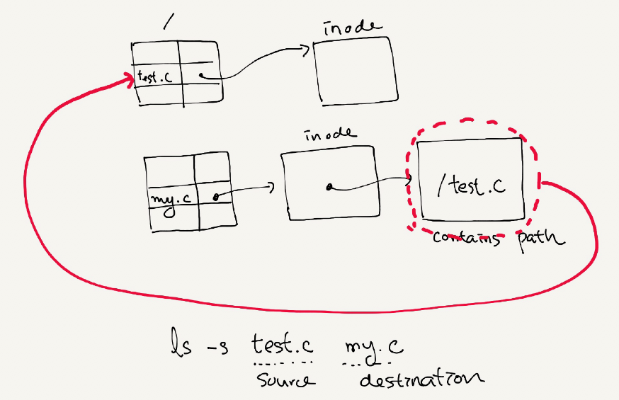
Symbolic Links
Symbolic link
Special file that contains path to the source directory.
Hard Link cannot create to a directory.
Hard Link cannot create to a file to other partition.
An example of symbolic link
prompt> echo hello > file
prompt> ln –s file file2 /* option –s : create a symbolic link, */
prompt> cat file2
hello

Slide 30
Symbolic Links (Cont.)
Symbolic link is different file type.
Symbolic link is subject to the dangling reference.
prompt> ls -al
drwxr-x--- 2 remzi remzi 29 May 3 19:10 ./
drwxr-x--- 27 remzi remzi 4096 May 3 15:14 ../ /* directory */
-rw-r----- 1 remzi remzi 6 May 3 19:10 file /* regular file */
lrwxrwxrwx 1 remzi remzi 4 May 3 19:10 file2 -> file /* symbolic link */
prompt> echo hello > file
prompt> ln -s file file2
prompt> cat file2
hello
prompt> rm file
prompt> cat file2
cat: file2: No such file or directory

Slide 31
Summary
Create file
read/write/lseek
mkdir/readdir
fsync
hardlink/softlink

