Slide 1
Operating Systems

Slide 2
38. RAID

Slide 3
RAID (Redundant Array of Inexpensive Disks)
RAID is to use multiple disks to build faster, bigger, and more reliable disk system.
RAID is arranged into six different levels.
  RAID Level 0: Striping multiple disks
  RAID Level 1: Use mirroring
  RAID Level 4, level 5: Parity based redundancy

Slide 4
Evaluation
Capacity
  N disks, B blocks per disk
  N*B blocks in total → How much useful capacity is available to the clients of RAID?
Reliability
  How many disk faults can the RAID tolerate ?
Performance
  Read
  write

Slide 5
RAID Level 0
RAID Level 0 is the simplest form as striping blocks.
  Spread the blocks across the disks in a round-robin fashion.
Disk 0 | Disk 1 | Disk 2 | Disk 3
0 | 1 | 2 | 3
4 | 5 | 6 | 7
8 | 9 | 10 | 11
12 | 13 | 14 | 15
RAID-0: Simple Striping

Slide 6
RAID Level 0 (Cont.)
Chunk size
  Small chunk:
    more intra-file parallelism
    Larger positioning time: positioning time is the max positioning time of the disks
  Large chunk:
    Reduced intra-file parallelism
    Smaller positioning time
An example of RAID Label 0 with a bigger chunk size
  Chunk size : 2 blocks (8KB)
Disk 0 | Disk 1 | Disk 2 | Disk 3
0 | 2 | 4 | 6 | chunk size: 2 blocks
1 | 3 | 5 | 7
5 | 10 | 12 | 14
9 | 11 | 13 | 15
Striping with a Bigger Chunk Size

Slide 7
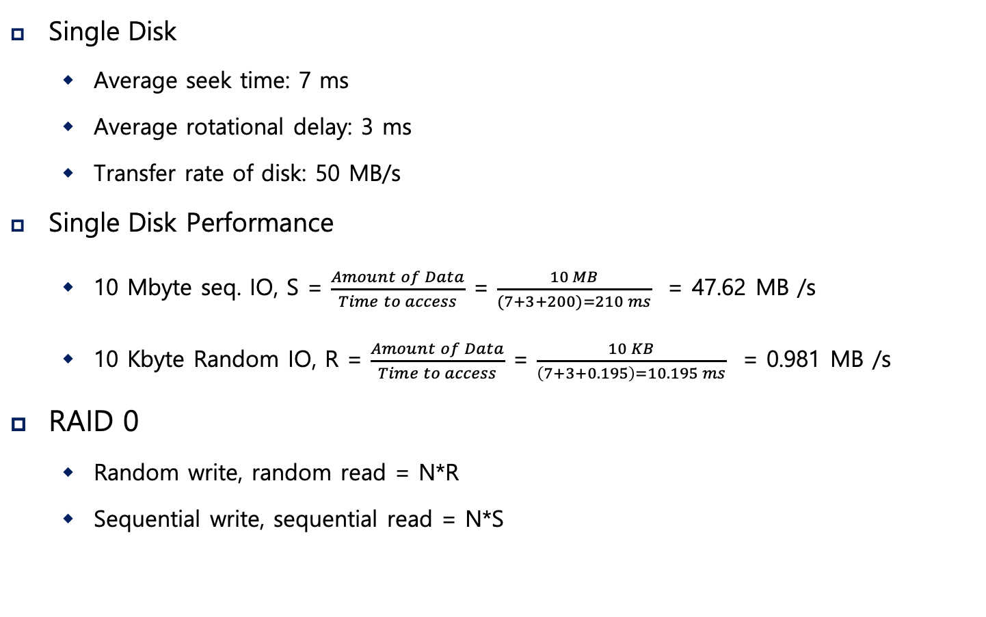
RAID Level 0 Analysi
Single Disk
  Average seek time: 7 ms
  Average rotational delay: 3 ms
  Transfer rate of disk: 50 MB/s
Single Disk Performance
  10 Mbyte seq. IO, S = $\frac{Amount of Data}{Time to access}$ = $\frac{10 MB}{(7+3+200)=210 ms}$ = 47.62 MB /s
  10 Kbyte Random IO, R = $\frac{Amount of Data}{Time to access}$ = $\frac{10 KB}{\left(7+3+0.195\right)=10.195 ms}$ = 0.981 MB /s
RAID 0
  Random write, random read = N*R
  Sequential write, sequential read = N*S

Slide 8
RAID Level 1
RAID Level 1 is mirroring
  Copy more than one of each block in the system.
  Copy block places on a separate disk to tolerate the disk failures.
Disk 0 | Disk 1 | Disk 2 | Disk 3
0 | 0 | 1 | 1
2 | 2 | 3 | 3
4 | 4 | 5 | 5
6 | 6 | 7 | 7
Simple RAID-1: Mirroring

Slide 9
RAID level 1
Capacity N*B/2
Reliability
  From one to upto N/2 depending upon the failure disk
Performance
  Sequential write: N*S/2
  Sequential read: N*S/2
  Random write: N*R/2
  Random Read: N*R

Slide 10
RAID Level 4
RAID Level 4 is to add redundancy to a disk array as parity.
* P: Parity
Disk 0 | Disk 1 | Disk 2 | Disk 3 | Disk 4
0 | 1 | 2 | 3 | P0
4 | 5 | 6 | 7 | P1
8 | 9 | 10 | 11 | P2
12 | 13 | 14 | 15 | P3
Simple RAID-4 with parity
Disk 0 | Disk 1 | Disk 2 | Disk 3 | Disk 4
0 | 0 | 1 | 1 | xor(0,0,1,1)
0 | 1 | 0 | 0 | Xor(0,1,0,0)

Slide 11
RAID Level 4 (Cont.)
The simple RAID Level 4 optimization known as a Full-stripe write.
  Calculate the new value of P0 (Parity 0)
  Write all of the blocks to the five disks above in parallel
  Full-stripe writes are the most efficient way
Disk 0 | Disk 1 | Disk 2 | Disk 3 | Disk 4
0 | 1 | 2 | 3 | P0
4 | 5 | 6 | 7 | P1
8 | 9 | 10 | 11 | P2
12 | 13 | 14 | 15 | P3
Full-stripe Writes In RAID-4

Slide 12
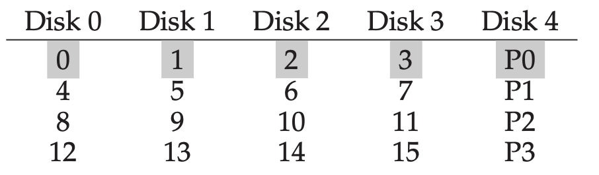
Anlaysis
Capacity: (N-1)*B
Sequential read: (N-1)*S
Sequential write: (N-1)*S for full stripe write
Random read: (N-1)*R

Slide 13
Analysis
Random write: Read-Modify-Write
  Additive Parity update: read all blocks, update the block, compute the new parity and write the updated block and the updated parity.
  Subtractive parity update: read the parity, write (new xor old) xor (old parity). (read on parity disk)
  For each write, the RAID perform 4 physical I/O. (two read and writes)
Disk 0 | Disk 1 | Disk 2 | Disk 3 | Disk 4
0 | 1 | 2 | 3 | P0
*4 | 5 | 6 | 7 | +P1
8 | 9 | 10 | 11 | P2
12 | *13 | 14 | 15 | +P3
Random write performance: (R/2) MB/sec
Small write problem happens

Slide 14
RAID Level 5
RAID Level 5 is solution of small write problem.
  small write problem cause parity-disk bottleneck of RAID Level 4.
  works almost identically to RAID-4, except that it rotates the parity blocks across drives.
RAID Level 5’s Each stripe is now rotated across the disks.
Disk 0 | Disk 1 | Disk 2 | Disk 3 | Disk 4
0 | 1 | 2 | 3 | P0
5 | 6 | 7 | P1 | 4
10 | 11 | P2 | 8 | 9
15 | P3 | 12 | 13 | 14
P4 | 16 | 17 | 18 | 19
RAID-5 with Rotated Parity

Slide 15
Analysis
Capacity: (N-1)*B
Reliability: 1
Performance
  Sequential read, sequential write: (N-1)S
  Random read: N*R
  Random write: single write can cause 4 IO’s (two read, two write), All N disks can work in parallel: (N*R)/4

Slide 16
Summary
 | RAID-0 | RAID-1 | RAID-4 | RAID-5
Capacity | N | N/2 | N-1 | N-1
Reliability | 0 | 1 (for sure) N/2 (if lucky) | 1 | 1
Throughput
Sequential Read | NS | (N/2)S | (N-1)S | (N-1)S
Sequential Write | NS | (N/2) S | (N-1)S | (N-1)S
Random Read | NR | NR | (N-1)R | NR
Random Write | NR | (N/2)R | R/2 | (N/4)R
Latency
Read | D | D | D | D
Write | D | D | 2D | 2D
RAID-5 with Rotated Parity

