Slide 1
Operating Systems

Slide 2
37. Hard Disk Drives
Operating System: Three Easy Pieces

Slide 3
Base Geometry
Disk arm
Spindle
Disk head
Platter
Surface
Surface

Slide 4
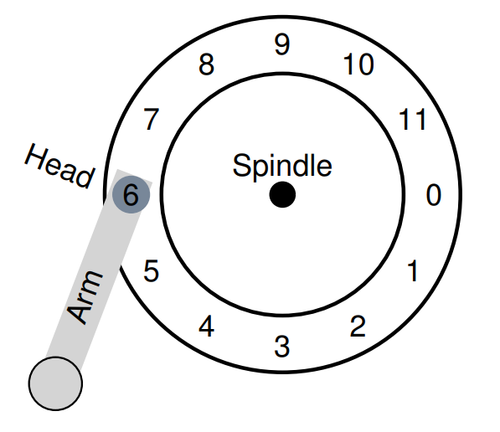
Base Geometry (Cont.)
Track
Sector
(512 Byte)

Slide 5
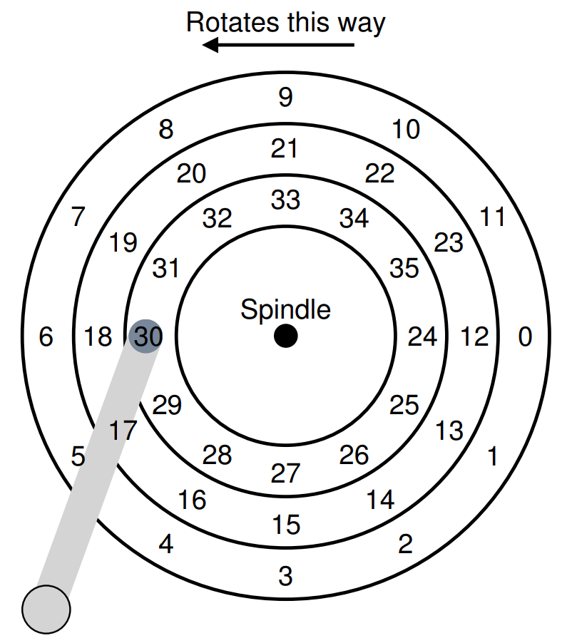
A Simple Disk Drive
Rotation Delay
If the full rotation delay is R,
the rotation delay of (30→24) is $\frac{R}{2}$

Slide 6
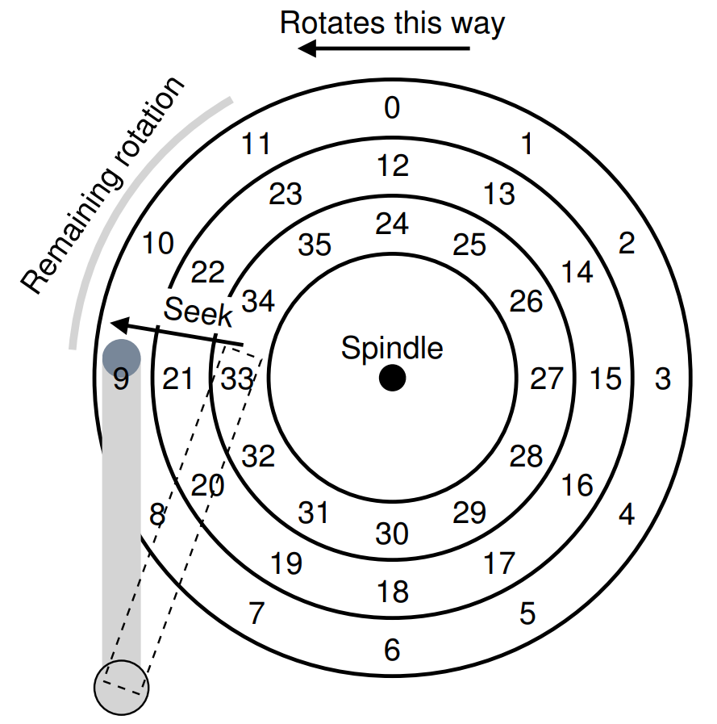
A Simple Disk Drive (Cont.)
Seek Time
9
Phases of seek
Acceleration
→
Coasting
→
Deceleration
→
Setting time
(about 0.5~2 ms)

Slide 7
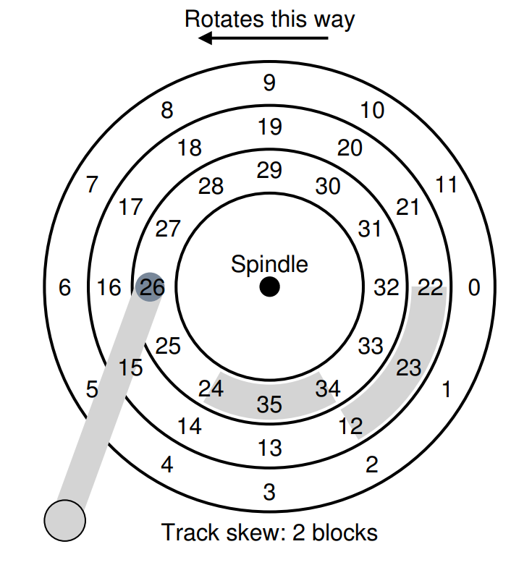
A Simple Disk Drive (Cont.)
Track skew
Make sure that sequential reads can be properly serviced even when crossing track boundaries
Without such skew, the head would be moved to the next track but the desired next block would have already rotated under the head

Slide 8
A Simple Disk Drive (Cont.)
Multi-zoned
Outer tracks tend to have more sectors than inner tracks, because of result of geometry
0
11
1
12
10
19
13
2
Spindle
9
18
14
3
8
17
15
4
16
7
5
6

Slide 9
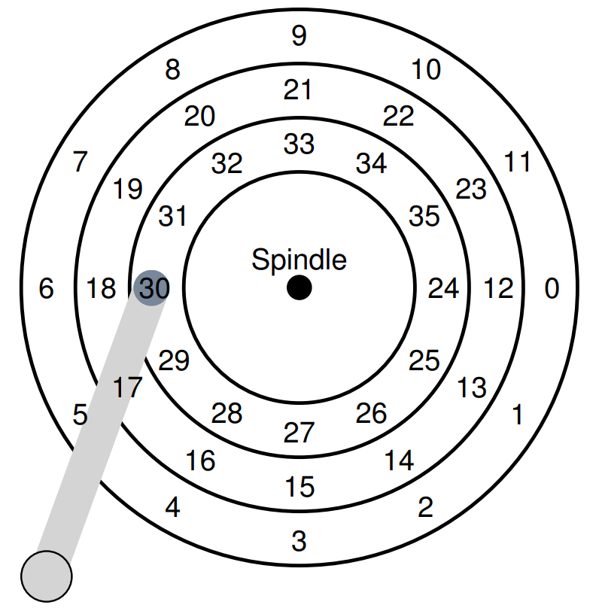
A Simple Disk Drive (Cont.)
Cache (Track buffer)
30
22
10
4
27
…
Small amount of memory
(usually around 8 or 16MB)
Hold data read from or written to the disk
Allow the drive to quickly respond to requests

Slide 10
A Simple Disk Drive (Cont.)
Cache (Track buffer)
Write-Back
30
22
10
4
27
…
Acknowledge the write has completed when it has put the data in its memory
Write-Through
Acknowledge after the write has actually been written to disk

Slide 11
I/O Time: Doing The Math
I/O Time
I/O Rate

Slide 12
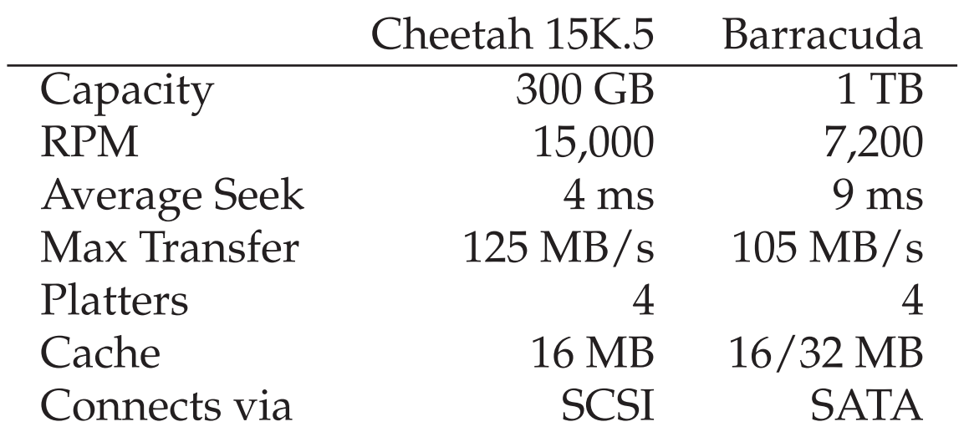
I/O Time: Doing The Math (Cont.)
4KB Random Write Example
= 4ms
= 15,000 RPM(= 250RPS = 4ms / 1 rotation) / 2
= 2ms
= 4KB / 125(MB/s)
= 30us
= 4ms + 2ms + 30us ≒ 6ms
= 4KB / 6ms = 0.66MB/s

Slide 13
I/O Time: Doing The Math (Cont.)
Sequential Write Example
= 4ms
= 15,000 RPM(= 250RPS = 4ms / 1 rotation) / 2
= 2ms
= 100MB / 125(MB/s)
= 800ms
= 4ms + 2ms + 800ms = 806ms ≒ 800ms
= 100MB / 800ms = 125MB/s

Slide 14
I/O Time: Doing The Math (Cont.)
Performance
vs
Capacity
Random Write
vs
Sequential Write

Slide 15
Disk Scheduling: FCFS
How to order the services for the requests in the queue?
Illustration shows total head movement of 640 cylinders.
Queue = 98, 183, 37, 122, 14, 124, 65, 67 Head starts at 53
0
14
37
53
65
67
98
122
124
183
199
1
2
3
4
5
6
7
8

Slide 16
SSTF
Selects the request with the minimum seek time from the current head position.
SSTF scheduling is a form of SJF scheduling; may cause starvation of some requests.
Illustration shows total head movement of 236 cylinders.

Slide 17
SSTF (Cont.)
Queue = 98, 183, 37, 122, 14, 124, 65, 67 Head starts at 53
0
14
37
53
65
67
98
122
124
183
199
1
2
3
4
5
6
7
8

Slide 18
SCAN
The disk arm starts at one end of the disk, and moves toward the other end, servicing requests until it gets to the other end of the disk, where the head movement is reversed and servicing continues.
Sometimes called the elevator algorithm.
Illustration shows total head movement of 208 cylinders.

Slide 19
SCAN (Cont.)
Queue = 98, 183, 37, 122, 14, 124, 65, 67 Head starts at 53
0
14
37
53
65
67
98
122
124
183
199
1
2
3
4
5
6
7
8
9

Slide 20
C-SCAN
Provides a more uniform wait time than SCAN.
The head moves from one end of the disk to the other. servicing requests as it goes. When it reaches the other end, however, it immediately returns to the beginning of the disk, without servicing any requests on the return trip.
Treats the cylinders as a circular list that wraps around from the last cylinder to the first one.

Slide 21
C-SCAN (Cont.)
Queue = 98, 183, 37, 122, 14, 124, 65, 67 Head starts at 53
0
14
37
53
65
67
98
122
124
183
199
1
2
3
4
5
6
7
8
9
10

Slide 22
C-LOOK
Version of C-SCAN
Arm only goes as far as the last request in each direction, then reverses direction immediately, without first going all the way to the end of the disk.

Slide 23
C-LOOK (Cont.)
Queue = 98, 183, 37, 122, 14, 124, 65, 67 Head starts at 53
0
14
37
53
65
67
98
122
124
183
199
1
2
3
4
5
6
7
8

Slide 24
Selecting a Disk-Scheduling Algorithm
SSTF is common and has a natural appeal
SCAN and C-SCAN perform better for systems that place a heavy load on the disk.
Performance depends on the number and types of requests.
Requests for disk service can be influenced by the file-allocation method.
The disk-scheduling algorithm should be written as a separate module of the operating system, allowing it to be replaced with a different algorithm if necessary.
Either SSTF or LOOK is a reasonable choice for the default algorithm.

Slide 25
Disk Scheduling (Cont.)
I/O merging
Merge the continuous requests into a single two-block request
By waiting, a new and “better” request may arrive at the disk
Request
33
(wait)
8
(wait)
34
Merge
Issue
33
34
8

