Slide 1
Operating Systems

Slide 2
32. Common Concurrency Problems.

Slide 3
Atomicity-Violation Bugs
The desired serializability among multiple memory accesses is violated.
Simple Example found in MySQL:
Two different threads access the field proc_info in the struct thd.
1 Thread1::
2 if(thd->proc_info){
3 …
4 fputs(thd->proc_info , …);
5 …
6 }
7
8 Thread2::
9 thd->proc_info = NULL;

Slide 4
Atomicity-Violation Bugs (Cont.)
Solution: Simply add locks around the shared-variable references.
pthread_mutex_t lock = PTHREAD_MUTEX_INITIALIZER;
Thread1::
pthread_mutex_lock(&lock);
if(thd->proc_info){
…
fputs(thd->proc_info , …);
…
}
pthread_mutex_unlock(&lock);
Thread2::
pthread_mutex_lock(&lock);
thd->proc_info = NULL;
pthread_mutex_unlock(&lock);

Slide 5
Order-Violation Bugs
The desired order between two memory accesses is flipped.
i.e., A should always be executed before B, but the order is not enforced during execution.
Example:
The code in Thread2 seems to assume that the variable mThread has already been initialized (and is not NULL).
Thread1::
void init(){
mThread = PR_CreateThread(mMain, …);
}
Thread2::
void mMain(…){
mState = mThread->State ;
}

Slide 6
Order-Violation Bugs (Cont.)
Solution: Enforce ordering using condition variables
pthread_mutex_t mtLock = PTHREAD_MUTEX_INITIALIZER;
pthread_cond_t mtCond = PTHREAD_COND_INITIALIZER;
int mtInit = 0;
Thread 1::
void init(){
…
mThread = PR_CreateThread(mMain,…);
// signal that the thread has been created.
pthread_mutex_lock(&mtLock);
mtInit = 1;
pthread_cond_signal(&mtCond);
pthread_mutex_unlock(&mtLock);
…
}

Slide 7
Order-Violation Bugs (Cont.)
Thread2::
void mMain(…){
// wait for the thread to be initialized …
pthread_mutex_lock(&mtLock);
while(mtInit == 0)
pthread_cond_wait(&mtCond, &mtLock);
pthread_mutex_unlock(&mtLock);
mState = mThread->State;
…
}

Slide 8
Deadlock Bugs
Thread 1: lock(L1); lock(L2); | Thread 2: lock(L2); lock(L1);
The presence of a cycle
Thread1 is holding a lock L1 and waiting for another one, L2.
Thread2 that holds lock L2 is waiting for L1 to be release.
Thread 1
Holds
Lock L1
Wanted by
Wanted by
Lock L2
Thread 2
Holds

Slide 9
Conditions for Deadlock
Four conditions need to hold for a deadlock to occur.
If any of these four conditions are not met, deadlock cannot occur.
Condition | Description
Mutual Exclusion | Threads claim exclusive control of resources that they require.
Hold-and-wait | Threads hold resources allocated to them while waiting for additional resources
No preemption | Resources cannot be forcibly removed from threads that are holding them.
Circular wait | There exists a circular chain of threads such that each thread holds one more resources that are being requested by the next thread in the chain

Slide 10
Prevention – Circular Wait
Provide a total ordering on lock acquisition
This approach requires careful design of global locking strategies.
Example:
There are two locks in the system (L1 and L2)
We can prevent deadlock by always acquiring L1 before L2.

Slide 11
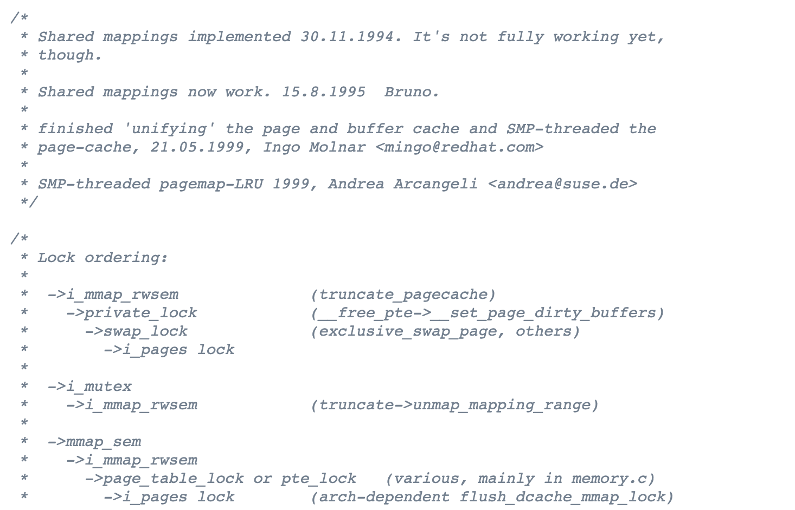
Avoiding Circular Wait
https://elixir.bootlin.com/linux/latest/source/mm/filemap.c

Slide 12
Prevention – Hold-and-wait
Acquire all locks at once, atomically.
This code guarantees that no untimely thread switch can occur in the midst of lock acquisition.
Problem:
Require us to know when calling a routine exactly which locks must be held and to acquire them ahead of time.
Decrease concurrency.
1 lock(prevention);
2 lock(L1);
3 lock(L2);
4 …
5 unlock(prevention);

Slide 13
Prevention – No Preemption
Multiple lock acquisition often gets us into trouble because when waiting for one lock we are holding another.
trylock()
Grab the lock (if it is available).
Or, return -1: you should try again later.
top:
lock(L1);
if( tryLock(L2) == -1 ){
unlock(L1);
goto top;
}

Slide 14
Prevention – No Preemption (Cont.)
livelock
Both systems are running through the code sequence over and over again.
Progress is not being made.
Solution:
Add a random delay before looping back and trying the entire thing over again.

Slide 15
Prevention – Mutual Exclusion
lock-free
Using powerful hardware instruction.
You can build data structures in a manner that does not require explicit locking.
int CompareAndSwap(int *address, int expected, int new){
if(*address == expected){
*address = new;
return 1; // success
}
return 0;
}

Slide 16
Prevention – lock free increment()
We now wanted to atomically increment a value by a certain amount:
Repeatedly tries to update the value to the new amount and uses the compare-and-swap to do so.
No lock is acquired
No deadlock can arise
livelock is still a possibility.
void AtomicIncrement(int *value, int amount){
do{
int old = *value;
}while( CompareAndSwap(value, old, old+amount)==0);
}

Slide 17
Prevention – lock free insert()
Solution:
Surrounding this code with a lock acquire and release.
wait-free manner using the compare-and-swap instruction
void insert(int value){
node_t * n = malloc(sizeof(node_t));
assert( n != NULL );
n->value = value ;
lock(listlock); // begin critical section
n->next = head;
head = n;
unlock(listlock) ; //end critical section
}
void insert(int value) {
node_t *n = malloc(sizeof(node_t));
assert(n != NULL);
n->value = value;
do {
n->next = head;
} while (CompareAndSwap(&head, n->next, n));
}

Slide 18
Insert with lock

Slide 19
Lock-free insert

Slide 20
Deadlock Avoidance via Scheduling
Deadlock Avoidance
Get the information about the locks various threads might grab during their execution.
schedule the threads in a way to guarantee no deadlock can occur.
In some scenarios, deadlock avoidance is preferable.
Problem: Global knowledge is required.

Slide 21
Example of Deadlock Avoidance via Scheduling (1)
We have two processors and four threads.
Lock acquisition demands of the threads:
A smart scheduler could compute that as long as T1 and T2 are not run at the same time, no deadlock could ever arise.
 | T1 | T2 | T3 | T4
L1 | yes | yes | no | no
L2 | yes | yes | yes | no
CPU 1
T3
T4
CPU 2
T1
T2

Slide 22
Example of Deadlock Avoidance via Scheduling (2)
More contention for the same resources
A possible schedule that guarantees that no deadlock could ever occur.
The total time to complete the jobs is lengthened considerably.
 | T1 | T2 | T3 | T4
L1 | yes | yes | yes | no
L2 | yes | yes | yes | no
CPU 1
T4
CPU 2
T1
T2
T3

Slide 23
Detect and Recover
Allow deadlock to occasionally occur and then take some action.
Example: if an OS froze, you would reboot it.
Many database systems employ deadlock detection and recovery technique.
A deadlock detector runs periodically.
Building a resource graph and checking it for cycles.
In deadlock, the system need to be restarted.

Slide 24
Summary
Non-deadlocked bugs
Atomicity violation
Ordering violation
Deadlock
Enforcing the lock order
Lockless mechanism

Slide 25
33. Event-based Concurrency (Advanced)

Slide 26
Event-based Concurrency
A different style of concurrent programming
Used in GUI-based applications, some types of internet servers.
The problem that event-based concurrency addresses is two-fold.
Managing concurrency correctly in multi-threaded applications.
Missing locks, deadlock, and other nasty problems can arise.
The developer has little or no control over what is scheduled at a given moment in time.

Slide 27
The Basic Idea: An Event Loop
The approach:
Wait for something (i.e., an “event”)to occur.
When it does, check what type of event it is.
Do the small amount of work it requires.
Example:
while(1){
events = getEvents();
for( e in events )
processEvent(e); // event handler
}
A canonical event-based server (Pseudo code)
How exactly does an event-based server determine
which events are taking place.

Slide 28
An Important API: select() (or poll())
Check whether there is any incoming I/O that should be attended to.
select()
Lets a server determine that a new packet has arrived and is in need of processing.
Let the service know when it is OK to reply.
timeout
NULL: Cause select() to block indefinitely until some descriptor is ready.
0: Use the call to select() to return immediately.
int select(int nfds,
fd_set * restrict readfds,
fd_set * restrict writefds,
fd_set * restrict errorfds,
struct timeval * restrict timeout);

Slide 29
Using select()
How to use select() to see which network descriptors have incoming messages upon them.
#include <stdio.h>
#include <stdlib.h>
#include <sys/time.h>
#include <sys/types.h>
#include <unistd.h>
int main(void) {
// open and set up a bunch of sockets (not shown)
// main loop
while (1) {
// initialize the fd_set to all zero
fd_set readFDs;
FD_ZERO(&readFDs);
// now set the bits for the descriptors
// this server is interested in
// (for simplicity, all of them from min to max)
…
Simple Code using select()

Slide 30
Using select()(Cont.)
int fd;
for (fd = minFD; fd < maxFD; fd++)
FD_SET(fd, &readFDs);
// do the select
int rc = select(maxFD+1, &readFDs, NULL, NULL, NULL);
// check which actually have data using FD_ISSET()
int fd;
for (fd = minFD; fd < maxFD; fd++)
if (FD_ISSET(fd, &readFDs))
processFD(fd);
}
}
Simple Code using select() (Cont.)

Slide 31
Why Simpler? No Locks Needed
The event-based server cannot be interrupted by another thread.
With a single CPU and an event-based application.
It is decidedly single threaded.
Thus, concurrency bugs common in threaded programs do not manifest in the basic event-based approach.

Slide 32
A Problem: Blocking System Calls
What if an event requires that you issue a system call that might block?
There are no other threads to run: just the main event loop
The entire server will do just that: block until the call completes.
Huge potential waste of resources
In event-based systems: no blocking calls are allowed.

Slide 33
A Solution: Asynchronous I/O
Enable an application to issue an I/O request and return control immediately to the caller, before the I/O has completed.
Example:
An Interface provided on Max OS X
The APIs revolve around a basic structure, the struct aiocb or AIO control block in common terminology.
struct aiocb {
int aio_fildes; /* File descriptor */
off_t aio_offset; /* File offset */
volatile void *aio_buf; /* Location of buffer */
size_t aio_nbytes; /* Length of transfer */
};

Slide 34
A Solution: Asynchronous I/O (Cont.)
Asynchronous API:
To issue an asynchronous read to a file
If successful, it returns right away and the application can continue with its work.
Checks whether the request referred to by aiocbp has completed.
An application can periodically pool the system via aio_error().
If it has completed, returns success.
If not, EINPROGRESS is returned.
int aio_read(struct aiocb *aiocbp);
int aio_error(const struct aiocb *aiocbp);

Slide 35
A Solution: Asynchronous I/O (Cont.)
Interrupt
Remedy the overhead to check whether an I/O has completed
Using UNIX signals to inform applications when an asynchronous I/O completes.
Removing the need to repeatedly ask the system.

Slide 36
Another Problem: State Management
The code of event-based approach is generally more complicated to write than traditional thread-based code.
It must package up some program state for the next event handler to use when the I/O completes.
The state the program needs is on the stack of the thread. → manual stack management

Slide 37
Another Problem: State Management (Cont.)
Example (an event-based system):
First issue the read asynchronously.
Then, periodically check for completion of the read.
That call informs us that the read is complete.
How does the event-based server know what to do?
int rc = read(fd, buffer, size);
rc = write(sd, buffer, size);

Slide 38
Another Problem: State Management (Cont.)
Solution: continuation
Record the needed information to finish processing this event in some data structure.
When the event happens (i.e., when the disk I/O completes), look up the needed information and process the event.

Slide 39
What is still difficult with Events.
Systems moved from a single CPU to multiple CPUs.
Some of the simplicity of the event-based approach disappeared.
It does not integrate well with certain kinds of systems activity.
Ex. Paging: A server will not make progress until page fault completes (implicit blocking).
Hard to manage overtime: The exact semantics of various routines changes.
Asynchronous disk I/O never quite integrates with asynchronous network I/O in as simple and uniform a manner as you might think.

Slide 40
ASIDE: Unix Signals
Provide a way to communicate with a process.
HUP (hang up), INT(interrupt), SEGV(segmentation violation), and etc.
Example: When your program encounters a segmentation violation, the OS sends it a SIGSEGV.
#include <stdio.h>
#include <signal.h>
void handle(int arg) {
printf("stop wakin’ me up...\n");
}
int main(int argc, char *argv[]) {
signal(SIGHUP, handle);
while (1)
; // doin’ nothin’ except catchin’ some sigs
return 0;
}
A simple program that goes into an infinite loop

Slide 41
ASIDE: Unix Signals (Cont.)
You can send signals to it with the kill command line tool.
Doing so will interrupt the main while loop in the program and run the handler code handle().
prompt> ./main &
[3] 36705
prompt> kill -HUP 36705
stop wakin’ me up...
prompt> kill -HUP 36705
stop wakin’ me up...
prompt> kill -HUP 36705
stop wakin’ me up...

