Slide 1
Operating Systems Lab Part 0: Installing PintOS

Slide 2
PintOS
Pintos?
Educational operating system for x86 architecture
Developed by Ben Pfaff in Stanford Univ, 2004
Support kernel threads, loading and running user programs, file system, etc.
Uses x86 simulators, such as Bochs or QEMU
Why we use Pintos?
It is important to implement a variety of concepts (threads, processes, memory management, and file systems) in the operating system manually
Commercial operating systems, such as Linux are very large(1 million lines). More than 80% of 1 million lines are device driver codes to support hardware.
Linux compile: takes at least an hour.
Pintos : Simple, easy to understand, easy to compile

Slide 3
Execution of Pintos
Pintos
Modify
x86
QEMU
Pintos
Modify
Pintos
Modify
Pintos
Modify
Install
x86
x86
x86
Ubuntu
virtualBox/Xen/
VMWare
QEMU
Install
QEMU
Install
QEMU
Install
Windows
Windows
Linux
MacOS
Linux
(Ubuntu, Fedora)
x86
x86
x86
x86
On Windows
WSL
On Mac
On Linux

Slide 4
Install pintos
Install pintos on Windows
VM + Linux + QEMU + PintOS
WSL + QEMU + PintOS
Install pintos on Linux
QEMU + PintOS
Install PintOS on MacOS
QEMU + PintOS

Slide 5
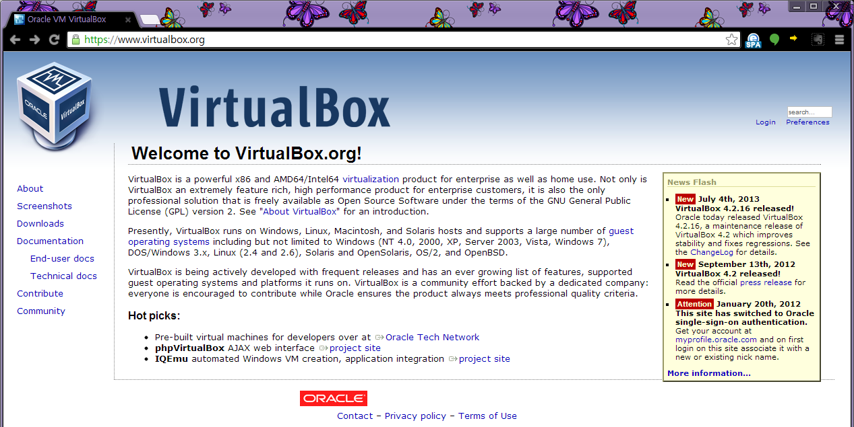
For Windows user: Install Virtual Box
Download Virtual Box at http://www.virtualbox.org and install it.
Here, Download

Slide 6
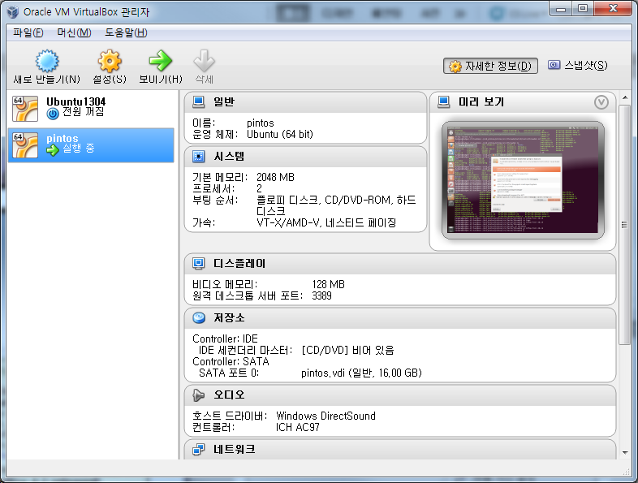
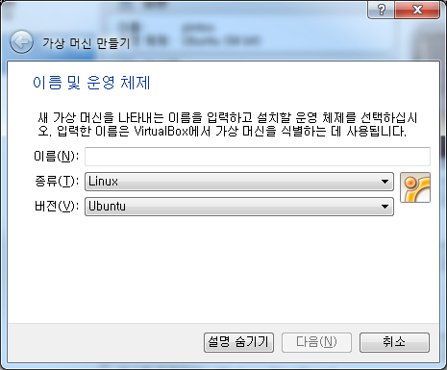
For Windows user: Install Ubuntu
Create a Linux Virtual Machine on VirtualBox, and then install Linux (Ubuntu 18.04 LTS)
Download ubuntu-18.04.6-desktop-amd64.iso : https://releases.ubuntu.com/18.04.6/?_ga=2.173865891.1436103949.1646090779-879543907.1646090779
Create the Virtual Machine

Slide 7
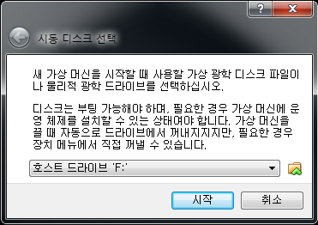
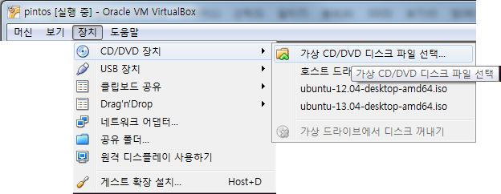
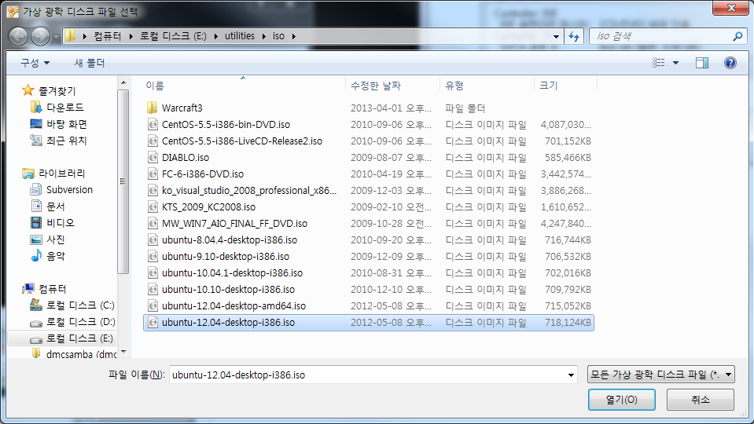
For Windows user: Install Ubuntu
Mount the Ubuntu image file, and install
or
Ubuntu-18.04.6-desktop-amd64.iso

Slide 8
For Windows user: Ubuntu Installation Complete
Ubuntu Installation Complete and booting

Slide 9
WSL: Install WSL (Recommended)
https://docs.microsoft.com/en-us/windows/wsl/install
Ensure using Windows 10 Version>=2004 or Windows 11
Open Powershell or Windows Terminal with administrator
Run wsl --install

Slide 10
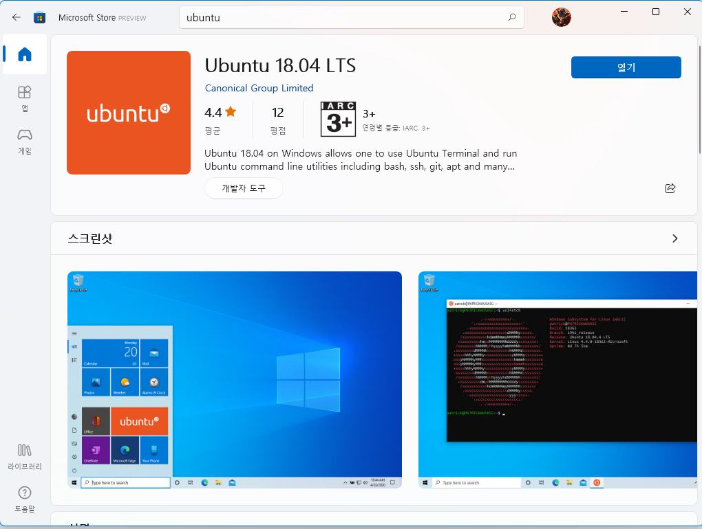
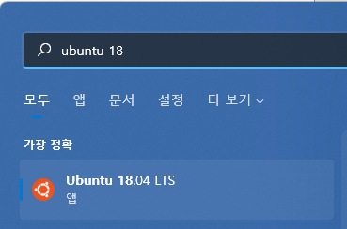
WSL: Install Ubuntu 18.04
Open Microsoft Store (https://aka.ms/wslstore)
Search ‘Ubuntu’ and find Ubuntu 18.04 LTS
Install it
Find the installed program and run it

Slide 11
WSL: Ubuntu Installation Complete
Set up account and you will see shell screen

Slide 12
For Linux: Install QEMU
Install QEMU on system (“qemu-system-i386” command is available after below command)
$ sudo apt-get install qemu
Make link “qemu” (“qemu” command is available after executing the command below)
$ sudo ln -s /usr/bin/qemu-system-i386 /usr/bin/qemu

Slide 13
For MacOS: Install QEMU
Install qemu
$ brew install qemu
Make link “qemu” (“qemu” command is available after below command)
$ sudo ln -s /usr/bin/qemu-system-i386 /usr/bin/qemu

Slide 14
Errors
Error 1: C compiler cannot create executables
Install gcc, g++ and library package
$ sudo apt-get install libc6-dev g++ gcc
Error 2: X windows libraries were not found
Install X windows library
$ sudo apt-get install xorg-dev

Slide 15
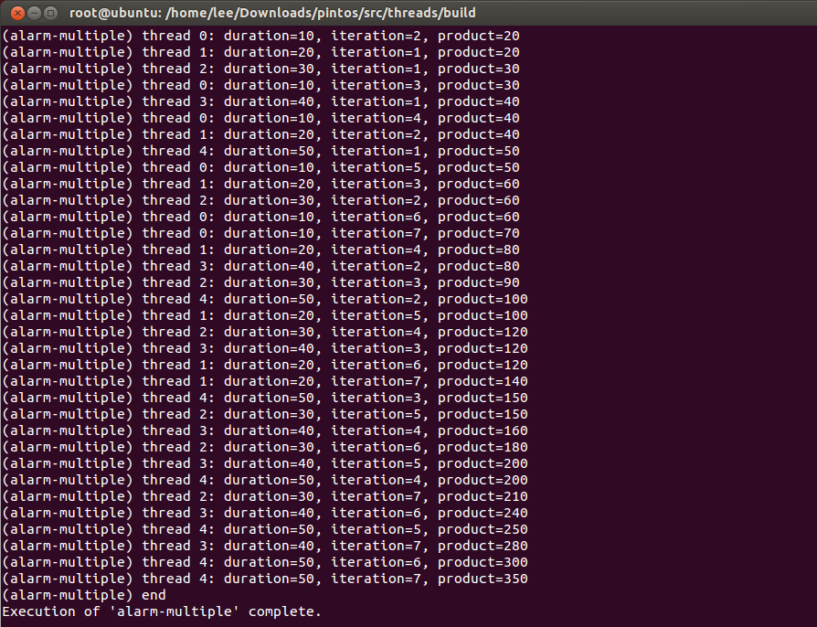
Install PintOS
Download the source code from the class piazza.
Unzip and untar
$ tar xvf pintos.tar.gz
Add export PATH=“location_to_your_pintos/src/utils:$PATH” to ~/.bashrc
Run source ~/.bashrc
cd to pintos/src/threads/
$ make
$ cd build
$ pintos --qemu -- -q run alarm-multiple

Slide 16
Install PintOS (MacOS)
Change the simulator to qemu in Make.vars in src directory.
SIMULATOR = --qemu
Trouble shooting I
Can’t exec “qemu”: No such file or directory at /home/arpith/pintos/src/utils/pintos line 923.
Change the line 623 of perl script (filename: pintos in src/utils) before: my (@cmd) = ('qemu’);
After: my (@cmd) = ('qemu-system-i386');

Slide 17
Install PintOS (MacOS)
Trouble shooting II
baekdu:threads yjwon$ make
cd build && /Applications/Xcode.app/Contents/Developer/usr/bin/make all
../../Make.config:37: *** Compiler (i386-elf-gcc) not found. Did you set $PATH properly? Please refer to the Getting Started section in the documentation for details. ***
/bin/sh: i386-elf-ld: command not found
make[1]: Nothing to be done for `all'.
Add the location of i386-elf-ld to your $PATH.
% echo PATH="$PATH:/opt/local/bin" >> ~/.bashrc
% source ~/.bashrc

Slide 18
Install PintOS (MacOS)
Trouble shoot III
cd build && /Applications/Xcode.app/Contents/Developer/usr/bin/make all
ld: unknown option: -melf_i386
gcc -m32 -E -nostdinc -I../.. -I../../lib -I../../lib/kernel -P ../../threads/kernel.lds.S > threads/kernel.lds.s
gcc -m32 -c ../../threads/start.S -o threads/start.o -Wa,--gstabs -nostdinc -I../.. -I../../lib -I../../lib/kernel -MMD -MF threads/start.d
clang: error: unsupported argument '--gstabs' to option 'Wa,'
make[1]: *** [threads/start.o] Error 1
make: *** [all] Error 2
It failed to locate the compiler. We need to enforce the compiler selection.

Slide 19
Install PintOS (MacOS)
Enforce the compiler selection. Change the compiler setting. Comment out the line 24-30 in src/Make.config as follows.
#ifneq (0, $(shell expr `uname -m` : '$(X86)'))
# CC = $(CCPROG)
# LD = ld
# OBJCOPY = objcopy
#else
# ifneq (0, $(shell expr `uname -m` : '$(X86_64)'))
# CC = $(CCPROG) -m32
# LD = ld -melf_i386
# OBJCOPY = objcopy
# else
CC = i386-elf-gcc
LD = i386-elf-ld
OBJCOPY = i386-elf-objcopy
# endif
#endif

Slide 20
Install PintOS (MacOS)
Trouble shoot IV
In normal situation, PintOS should quit with ‘-q’ option and shell needs to be ready to accept the next command. If the shell hangs, the PintOS failed to shutdown the system properly. There is a problem with the ACPI shutdown module. Please make the following update in src/devices/shutdown.c.
printf ("Powering off...\n"); serial_flush (); //add the following line ++ outw( 0x604, 0x0 | 0x2000 ); /* This is a special power-off sequence supported by Bochs and QEMU, but not by physical hardware. */ for (p = s; *p != '\0'; p++) outb (0x8900, *p);

Slide 21
GCC version issue
Downgrade the gcc version to 4.5 (recommended for pintos)
$ sudo apt-get install gcc-4.5
$ sudo update-alternatives --install /usr/bin/gcc gcc /usr/bin/gcc-4.5 50

